Slide 1



UNIT 2
Achievements
Part 2

Slide 2
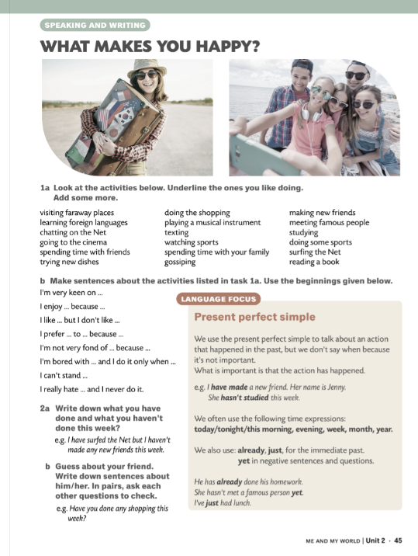
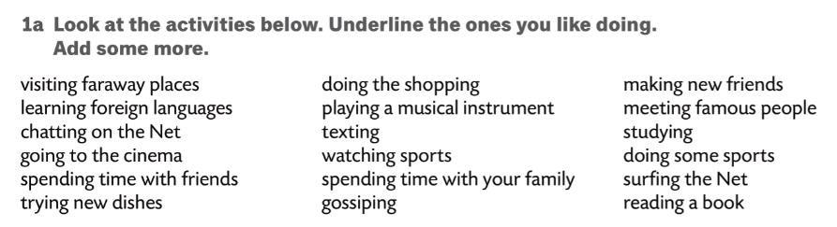
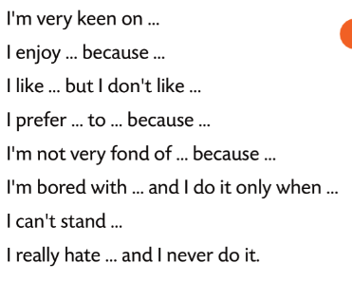

Slide 3
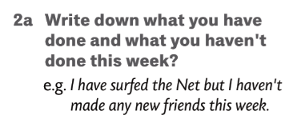
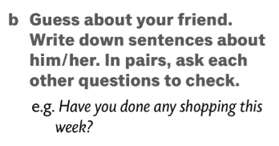
Ask your teacher questions to find out which of the things listed has he/she done this week.
Start your questions with ‘Have you ...?

Slide 4
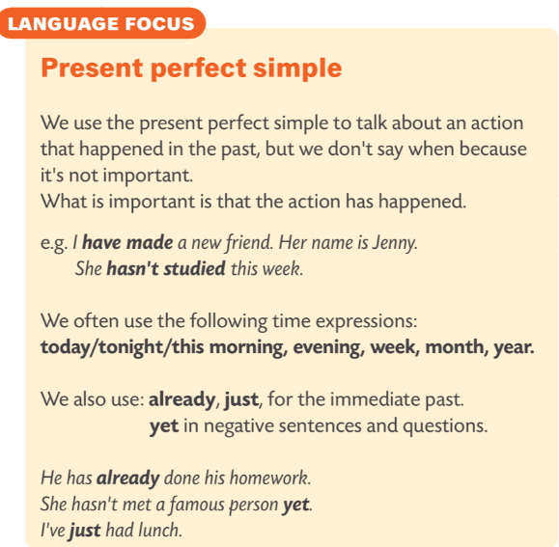
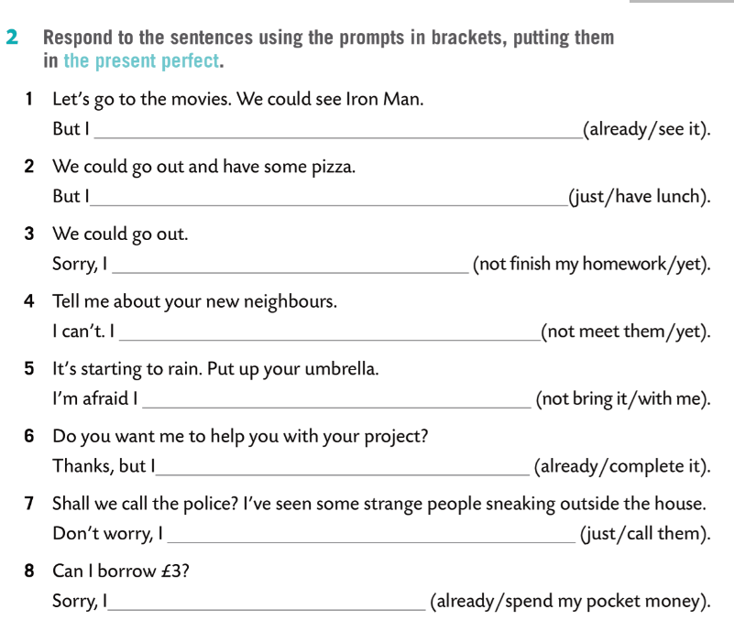
have already seen it
have just had lunch
haven’t finished my homework yet
haven’t met them yet
haven’t brought it with me.
have already completed it
have just called them
have already spent my pocket money

Slide 5
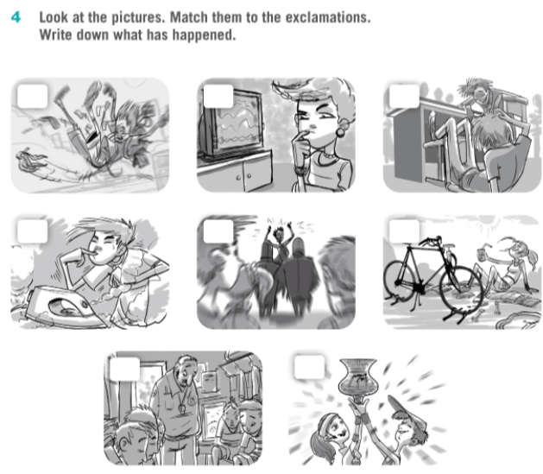
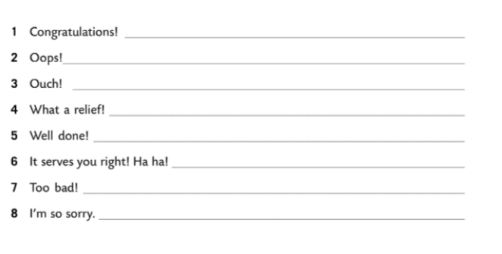
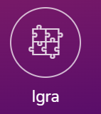
2
7
6
3
4
5
They have won a competition.
He has slipped on a banana skin.
8
1
He has burnt his finger.
The police have arrested the criminals.
She has repaired her bike.
He has fallen down.
The TV set has broken down.
They have lost the match.
PRESENT PERFECT SIMPLE

